Slide 1


Department of Electrical & Electronic Engineering
Green University of Bangladesh
Sequential Circuit
Prepared by
Rukhshana Parvin

Slide 2

Definition
1
The output of this circuit is dependent on the present input and previous output.

Slide 3
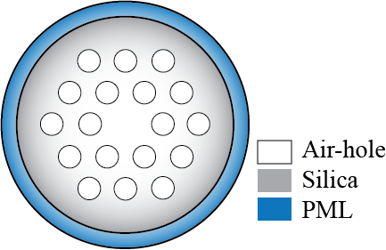
2
De (contd.)
2
Definition (contd.)
Photonic crstal fiber (PCF)
Micro-scaled light guiding medium.
Have periodic arrangement of one/two material over the cross-section that makes core-cladding region [1].
0
1
0
1
1
1
Output 1
Present input
Present Output
Carry 0
Fig. 1 Simple PCF structure (Adopted from [1])
Basic guiding properties of PCF [1]-[2]
Adder Circuit
Combinational Circuit
Dispersion
Refractive index (RI)
Birefringence
Confinement loss
Effective area
Waveguide dispersion
Material dispersion
Chromatic dispersion
Memory
Sequential Circuit
[1] M. A. Rahman, “Highly birefringent squeezed octagonal photonic crystal fiber with low loss,” B. S. Theses, Dept. of EEE, Rajshahi Univ of Engg. & Tech., Rajshahi, Bangladesh, Jan 2016.
[2] T. Yang et al., “Circular hole ENZ photonic crystal fiber exhibits high birefringence,” Opt. Express, vol. 26, no. 13, Jun 2018.

Slide 4
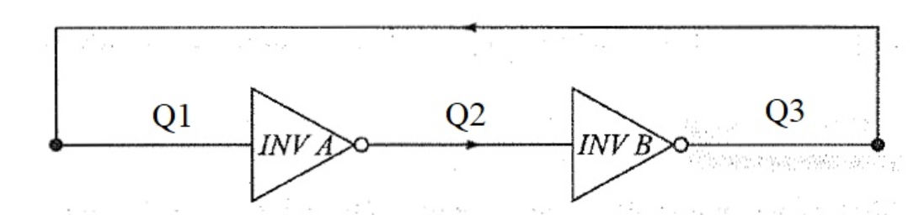
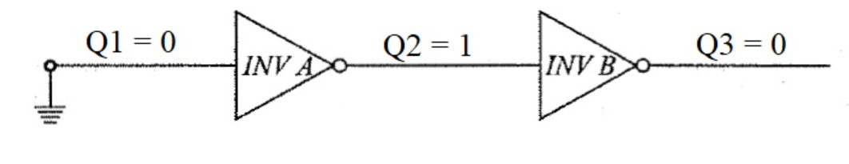
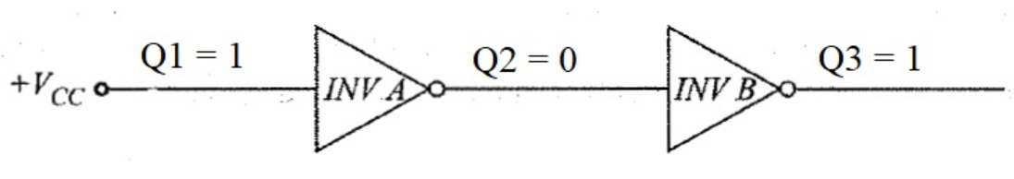
Cascaded Not Gate
3

Slide 5
Flip-flop
4
A Flip-Flop is a basic memory unit which can store 1-bit of digital information. It is a Bistable Electronic Circuit i.e., it has two stable states: HIGH or LOW.
What is Flip Flop?
In digital circuits, the flip-flop, is a kind of bi-stable multivibrator.
It is a Sequential Circuits / an electronic circuit which has two stable
states and thereby is capable of serving as one bit of memory , bit 1 or bit 0.

Slide 6
5
Flip-flop
Whenever we refer to the state of flip flop, we refer to the state of its normal output (Q).
Stable State 1 (HIGH) or 0 (LOW)
They have two stable conditions and can be
switched from one to the other by
appropriate inputs.
These stable conditions
are usually called the states of the circuit.

Slide 7
Flip-flop
6
Types Of Flip Flop
1. SR Flip
2. JK Flip Flop
4. JK Flip Flop With Pre-set And Clear
5. T Flip Flop
6. D Flip Flop
7. Master-Slave Edge-Triggered Flip-Flop

Slide 8
SR Flip-flop
7
The SR Flip Flop has two inputs,
SET (S) and RESET (R).
The SR Flip Flop has two
outputs, Q and Q
The Q output is considered the
normal output and is the one most used.
The other output Q is simply
the compliment of output Q

Slide 9
SR Flip Flop - NOR GATE LATCH
8
The NOR gate version has two inputs, SET (S) and RESET (R).
Two outputs, feedback mechanism.
The feedback mechanism is required to form a sequential circuit by connecting the output of NOR-1 to the input of NOR-2 and vice versa.
The circuit outputs depends on the
inputs and also on the outputs.
NOR-1
NOR-2

Slide 10
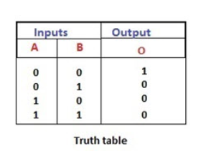
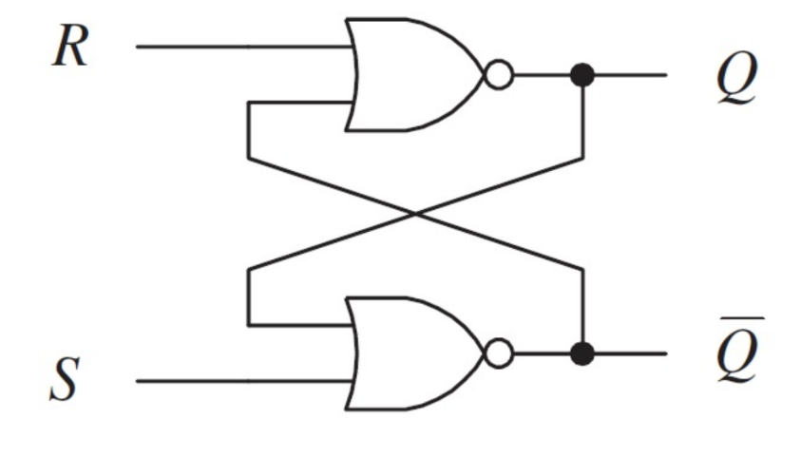
SR Flip Flop - NOR GATE LATCH
9
Case 1: R = 1 and S = 0
Truth Table of NOR gate
Q=0 Q’= 1
0
1
1
0

Slide 11
SR Flip Flop - NOR GATE LATCH
10
Case 2: R = 0 and S = 0
Truth Table of NOR gate
Q=0 Q’= 1
0
0
1
0
1
0
The output is unchanged

Slide 12
SR Flip Flop - NOR GATE LATCH
11
Case 3: R = 0 and S = 1
Truth Table of NOR gate
Q=1 Q’= 0
0
1
0
1
The System is Set

Slide 13
SR Flip Flop - NOR GATE LATCH
12
Case 4: R = 1 and S = 1
Truth Table of NOR gate
Forbidden
1
0
0
1
Forbidden

Slide 14
NOR GATE LATCH-Truth Table
13

Slide 15
NAND GATE LATCH
14
The NAND gate version has two inputs, SET (S) and RESET (R).
Two outputs, Q as normal output and Q’ as inverted output and feedback mechanism.
The feedback mechanism is required to form a sequential circuit by connecting the output of NAND-1 to the input of NAND-2 and vice versa.
The circuit outputs depends on the inputs and also on the outputs.

Slide 16
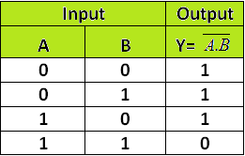
NAND GATE LATCH
15
Active low

Slide 17
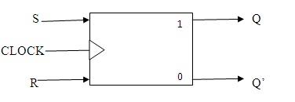
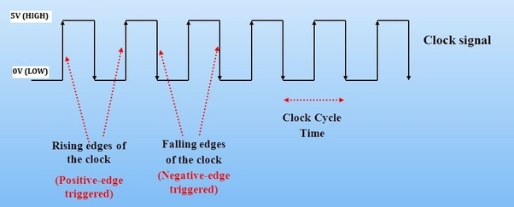
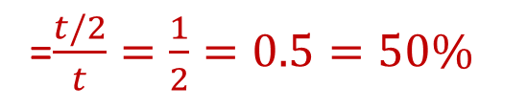

16
What is Clock?
Clock is a signal that goes low to high and again low and continue like that.
Why need Clocking?
To have Control over the Circuit or to fix the sequence of the Circuit
t
Duty Cycle= $\frac{Signal high time}{Time period}$
t/2
t/2
=$\frac{t/2}{t}=\frac{1}{2}=0.5=50\%$
50% Duty Cycle

Slide 18
Thank You

